Slide 1






Modelling Commons-based Peer Production: The ‘Commoners Framework’
Dr. Pete Barbrook-Johnson
Centre for Research in Social Simulation, University of Surrey, UK & Policy Studies Institute, University of Westminster, UK
Antonio Tenorio Fornes, Dr. Samer Hassan
GRASIA, Universidad Complutense de Madrid, Spain & Berkman Center for Internet and Society, Harvard University, USA

Slide 2
Overview
Background and Motivation
The Framework/Model
Preliminary results
Next steps
On-going!
On-going!

Slide 3
Background
New forms of productive organisation
Commons-based peer production (CBPP)
Non-hierarchical, contribution for free, for common goods
e.g. Wikipedia, Modzilla Firefox, Makerspaces, Rural hubs. NOT uber, NOT airbnb

Slide 4
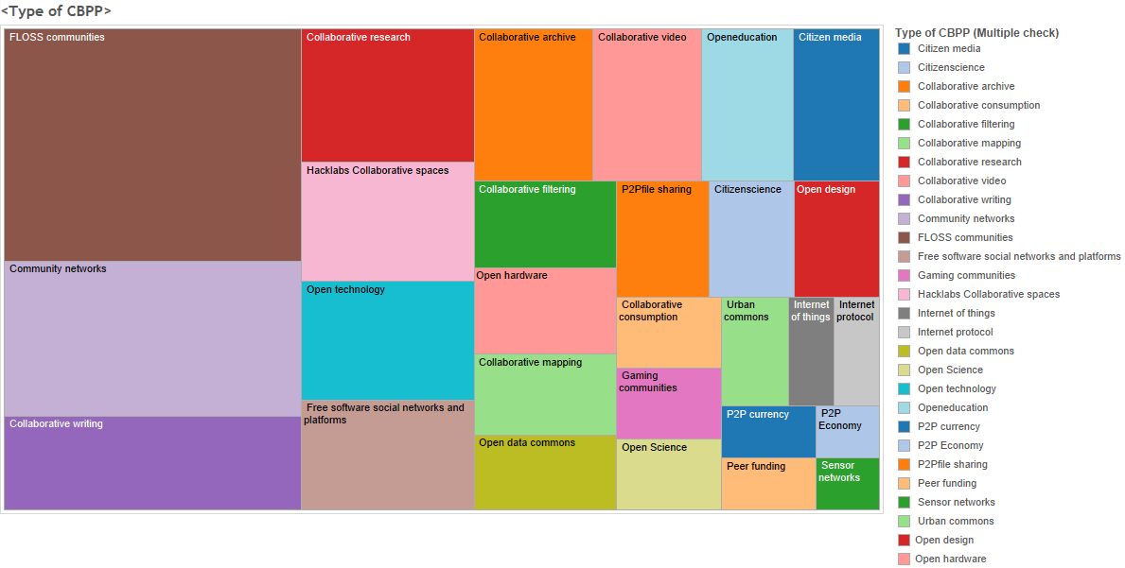
Motivation 1
Source: https://www.p2pvalue.eu/delimiting-commons-based-peer-production/

Slide 5
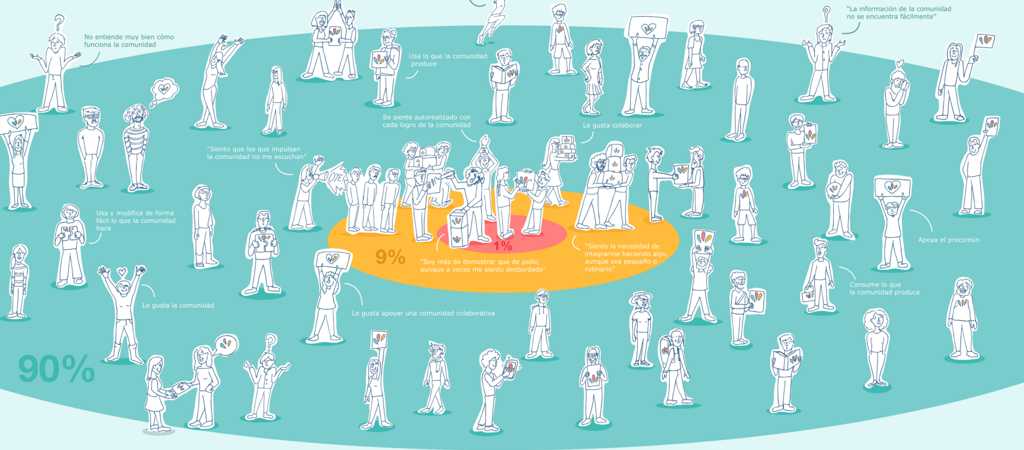
http://www.p2pvalue.eu/

Slide 6
Motivation
Prev work: contributions, governance, competition
Ethnographic / qual studies / SNA / quant / modelling
Can we formalise and model CBPP - both to aid theorising, and support policy?
E.g. Why do communities ‘experience’ such different growth/collapse? Can we model the effect of collaboration tools and use the model to inform their design?
Genesis of the project: v applied model for P2PValue project -> abstract model and reusable framework

Slide 7
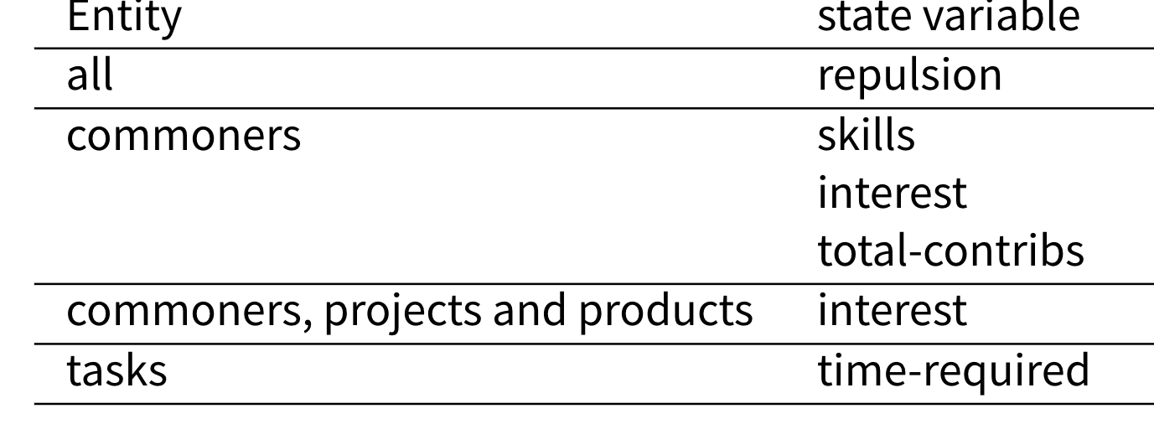
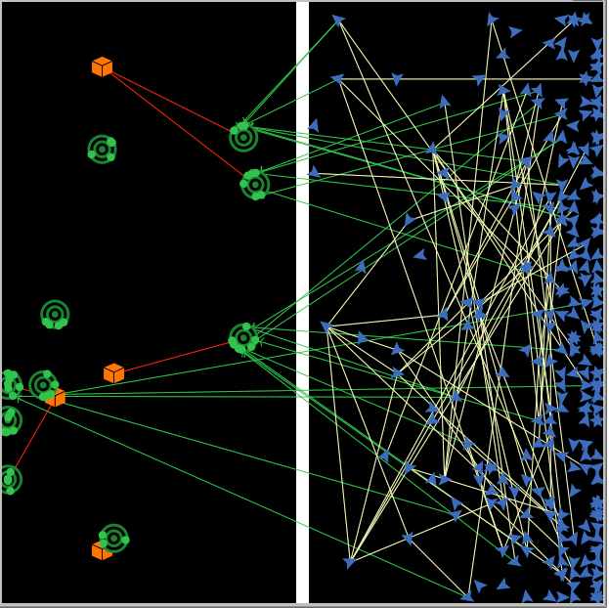
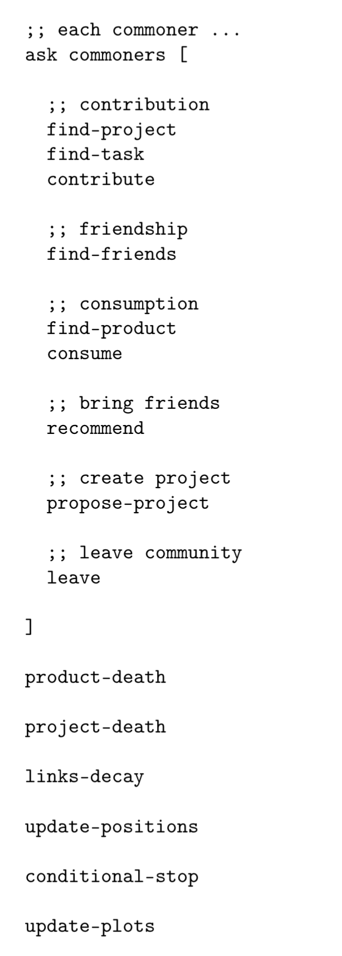
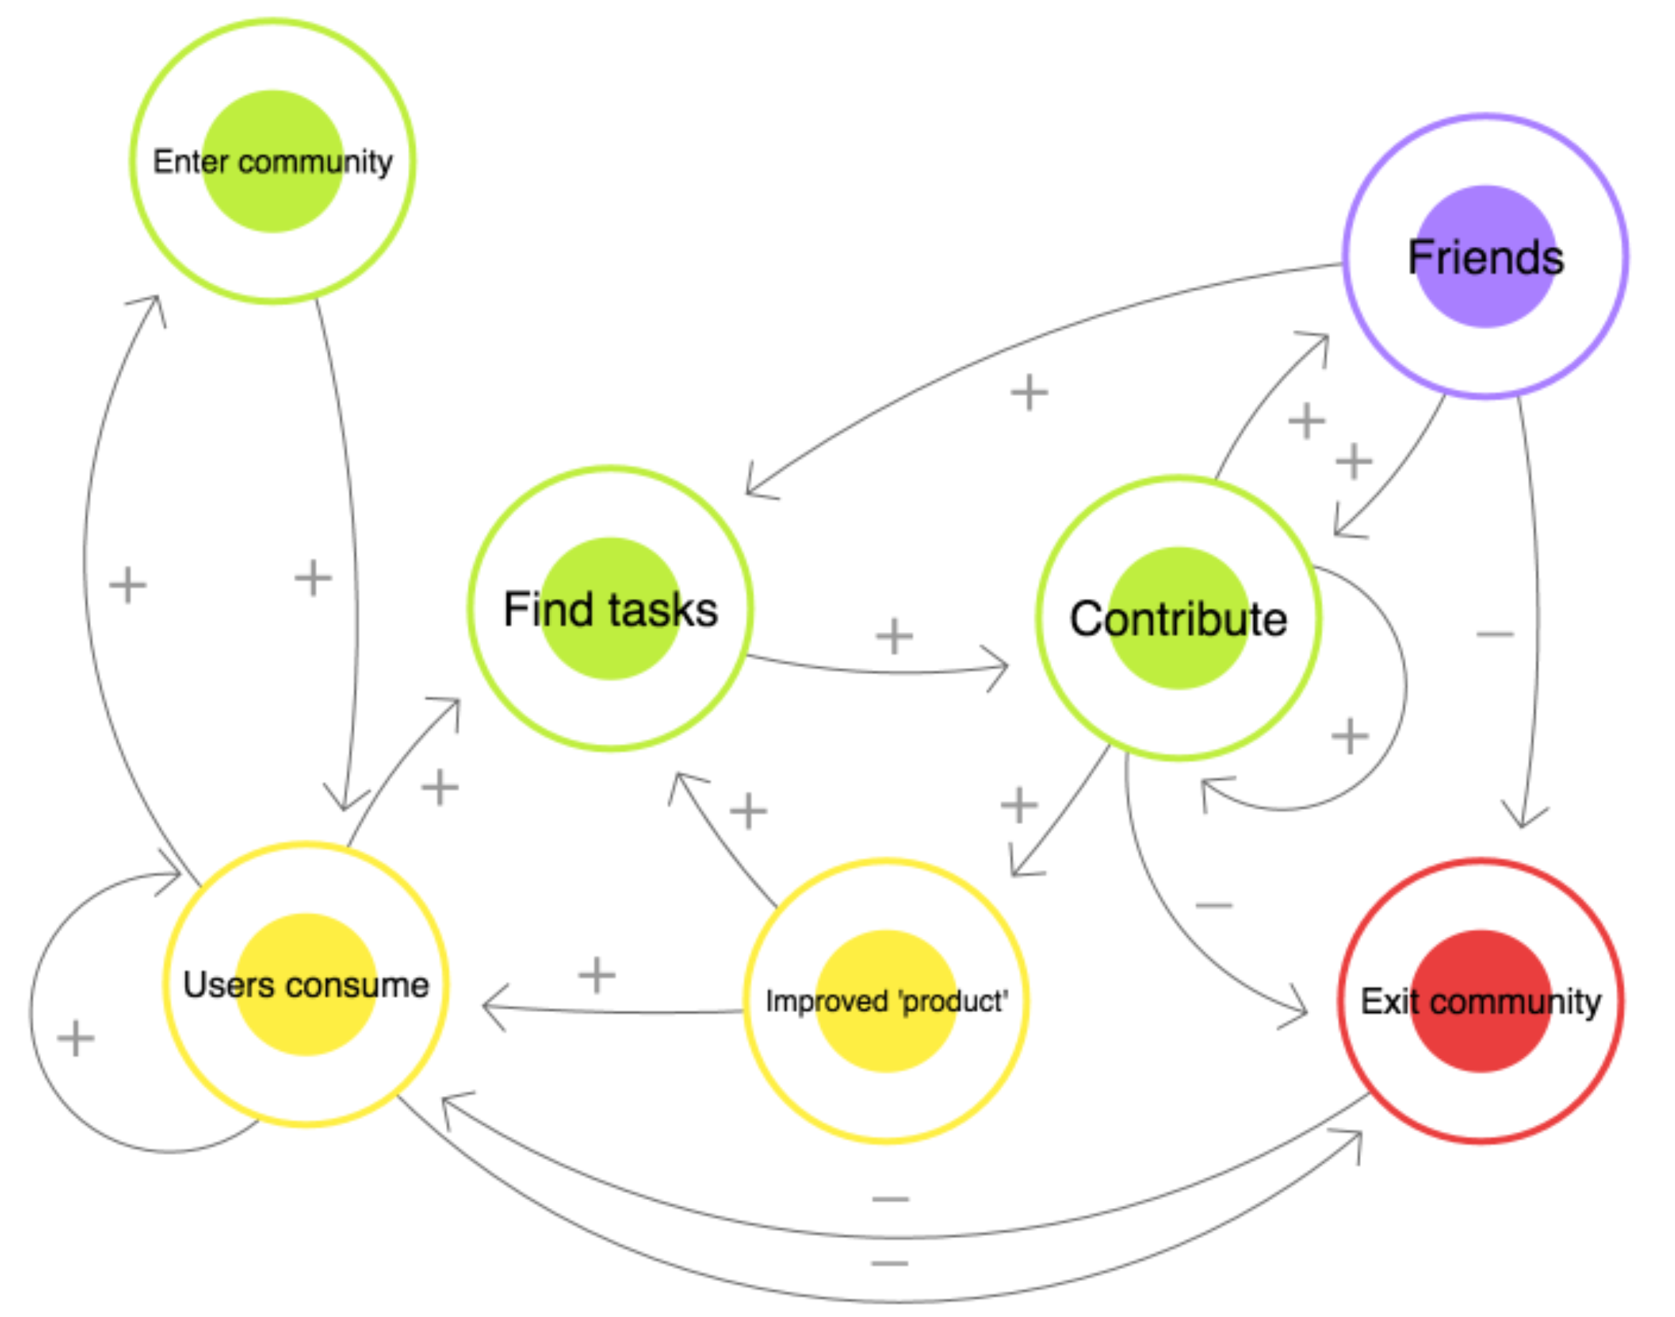
The Framework and Model

Slide 8
The Framework
Feedbacks and appeal modelled using space
Tick = day(ish)
Links for relationships
https://github.com/P2Pvalue/CommonersFramework
Model in NetLogo (uses Network Extension)
Most active
Most popular

Slide 9
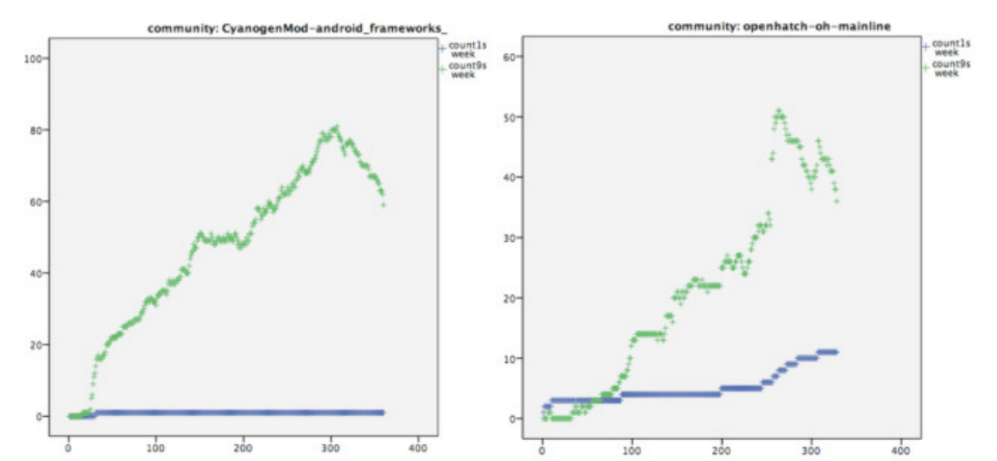
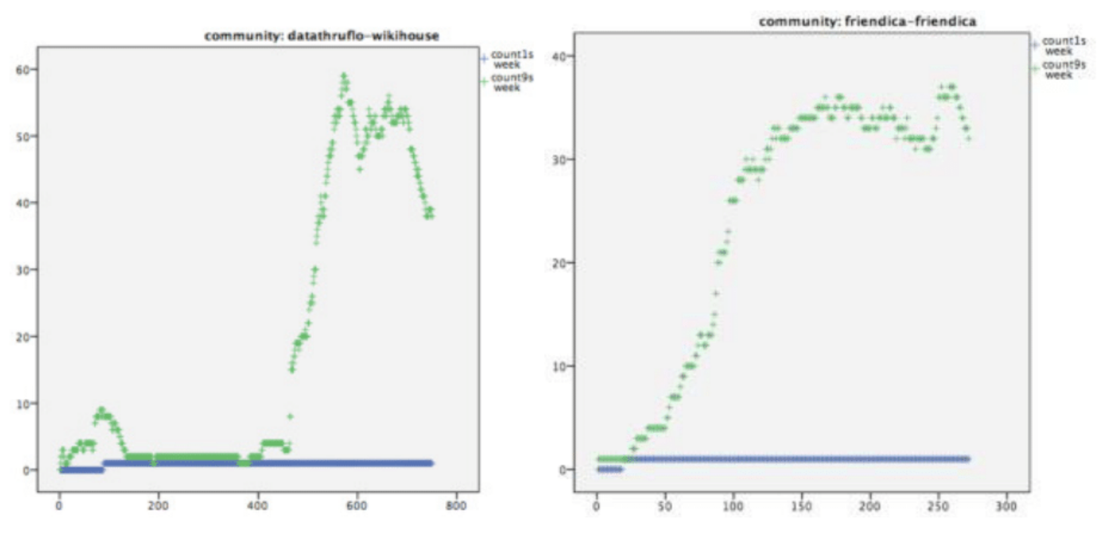
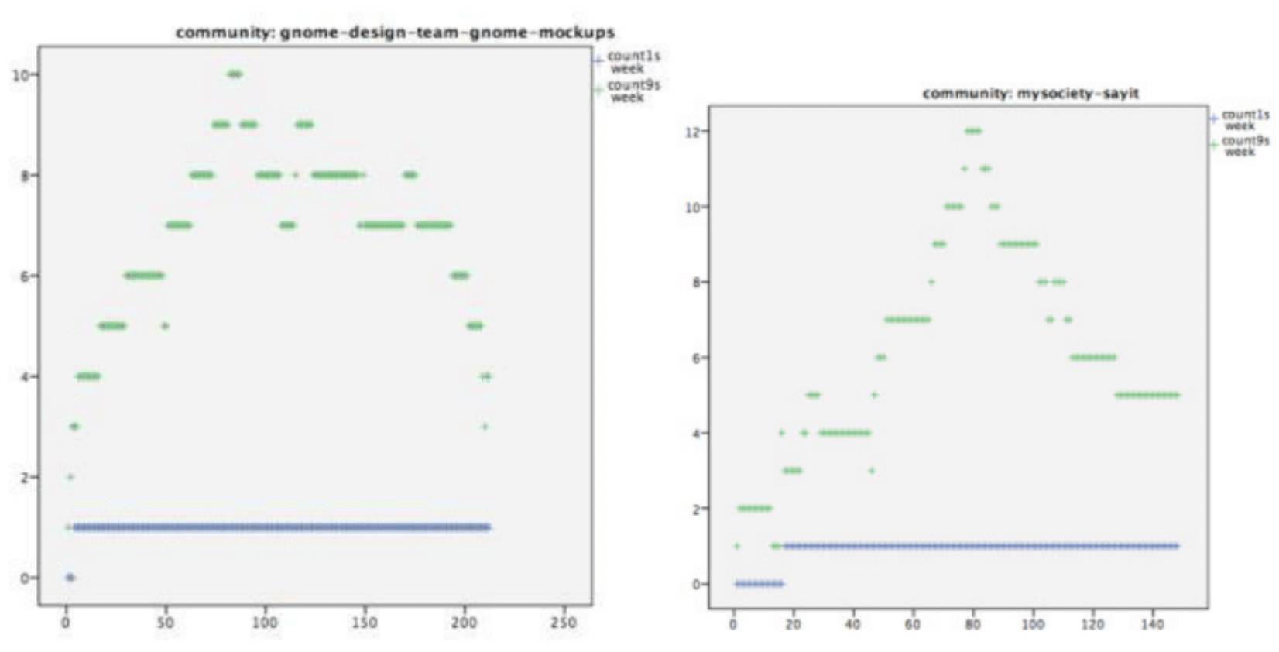
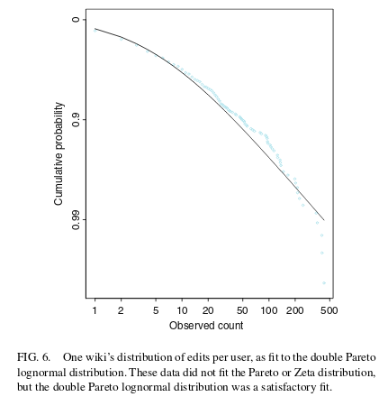
Prelim. Results
Exploring parameter space and relation to observed community behaviour
Power law cut-off.
Notes:
Exploring parameter space (graphs of parameter sweeping?)
Psquared exploration – 2 values per parameter
Exploration - join with R – test every 250 ticks – stop run if not close enough to power law
Plotting alpha parameter - close to that observed in data
Relation to observed community behaviour (explain how we will do this power law and timelines, any graphs/types?) SAY WE THINK IT DOES PRODUCE THEM
Truncated power law (I forget AT’s phrase for this – explain result, and how it helps us theorise/understand data)

Slide 10
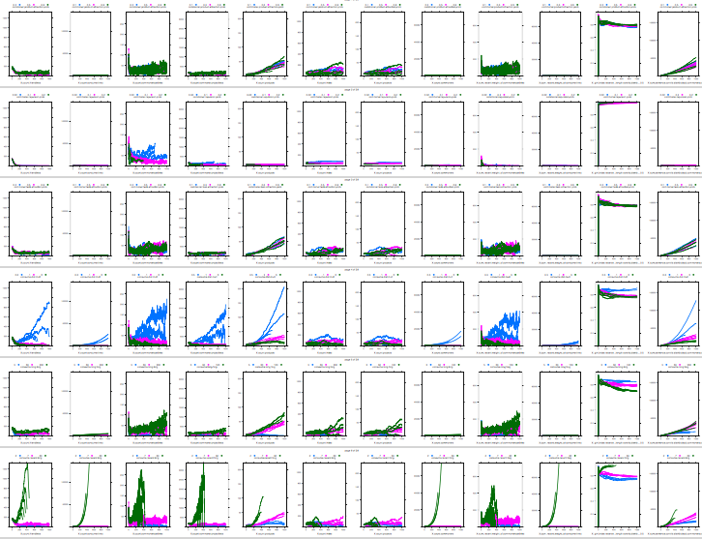
Prelim. Results – Exploring parameter space, and relation to observed behaviour
Observed behaviour
Reproducing power law – 1,9,90
Yes – but how robust?
Reproducing different growth and collapse patterns
Yes – but what proportions?
Data from real communities (online only?)
Notes:
Exploring parameter space (graphs of parameter sweeping?)
Psquared exploration – 2 values per parameter
Exploration - join with R – test every 250 ticks – stop run if not close enough to power law
Plotting alpha parameter - close to that observed in data
Relation to observed community behaviour (explain how we will do this power law and timelines, any graphs/types?) SAY WE THINK IT DOES PRODUCE THEM
Truncated power law (I forget AT’s phrase for this – explain result, and how it helps us theorise/understand data)

Slide 11
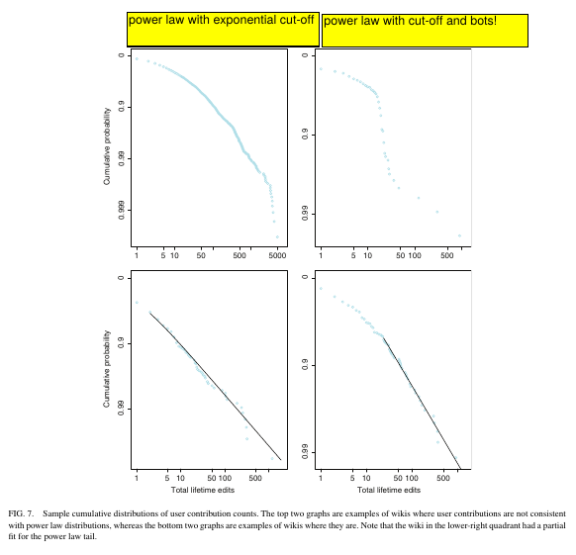
Prelim. Results – Power law exponential cut off 1
Does NOT fit
Fits
Stuckman, Jeffrey, and James Purtilo. “Analyzing the Wikisphere: Methodology and Data to Support Quantitative Wiki Research.”Journal of the American Society for Information Science and Technology 62, no. 8 (August 2011): 1564–76. doi:10.1002/asi.21576
Notes:
Here they complain about a distribution not fitting a power law but fitting better another esoteric distribution. The drop at the end is the exponential cut-off, (you can see that the proposed better distribution does not account for the last points).
Later they show some distribution that do not fit a power law and some that do. I have added some comments on why they do not fit the power law, first is a clear power law with exponential cut-off, the other is a power law with cut off that have bot accounts that break that cut off with several users contributing a lot even after the cut off. I hope it is somehow clear what I want to express, if not, please ask me and I will try to clarify:

Slide 12
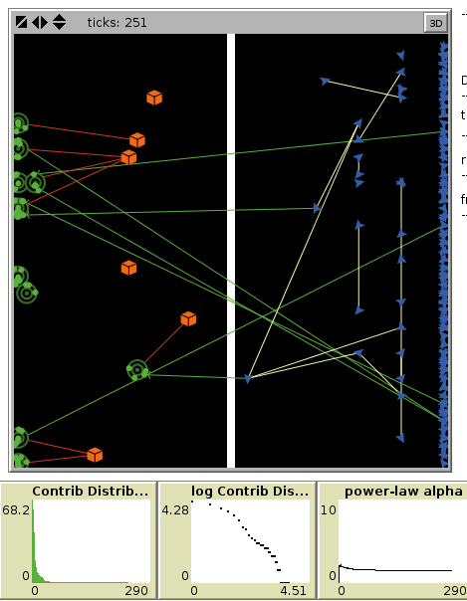
Prelim. Results – Power law exponential cut off 2
Implications
Core contributors don’t fit the power law – “equality in the 1%”?
Next steps
Robustness of this result
Gather data on more communities
Explore mechanisms in model behind this result
Notes:
Here they complain about a distribution not fitting a power law but fitting better another esoteric distribution. The drop at the end is the exponential cut-off, (you can see that the proposed better distribution does not account for the last points).
Later they show some distribution that do not fit a power law and some that do. I have added some comments on why they do not fit the power law, first is a clear power law with exponential cut-off, the other is a power law with cut off that have bot accounts that break that cut off with several users contributing a lot even after the cut off. I hope it is somehow clear what I want to express, if not, please ask me and I will try to clarify:
Following image is from our model. It shows the state of the agents, the distribution of work (both in normal plot and log-log plot) and the alpha parameter of the power law (the one that shows how unequal the power law is)

Slide 13
Next steps
‘Finish’ model analysis
Validate to power law and ‘histories’
Explore power law cut-off further in model and real data
Q: Do parameters of the power law (x^-alpha) at ‘start’ of community correlate with outcomes?
Presentation/dissemination for re-use of the framework by others simulating CBPP

Slide 14
Acknowledgements
Quintin Hogg Trust
P2PValue - http://www.p2pvalue.eu/
Questions?
Twitter - @bapeterj

